Slide 1
Amazon Product Sales Analysis | Power BI Dashboard Project
-LIKITHA S

Slide 2
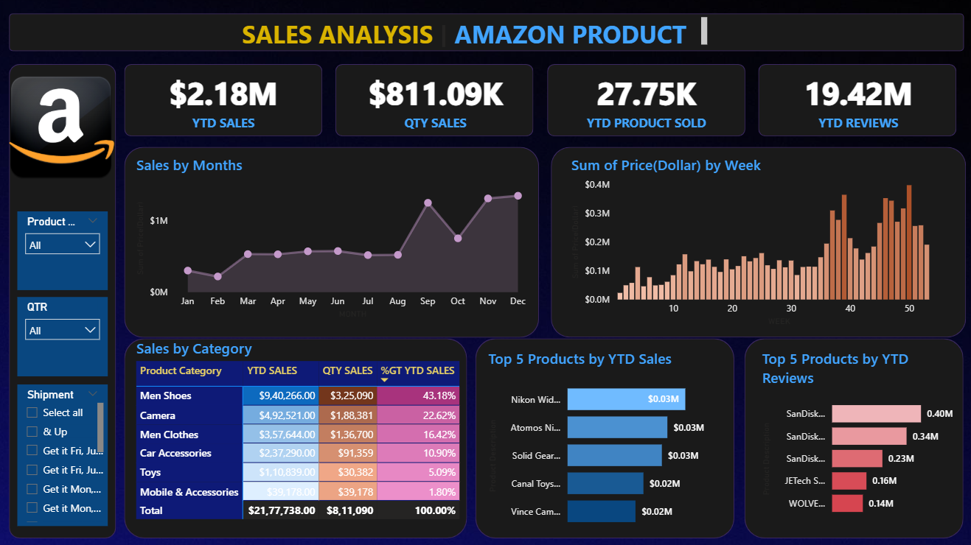
Amazon Product Sales Analysis

Slide 3
Project Objective
To analyze sales performance of Amazon products across categories and time
Identify top-performing products and customer review trends
Support data-driven business decisions using interactive dashboards

Slide 4
Tools & Data Used
Tools & Data
Power BI (main tool)
Excel (data source)
Data Fields:
Price, Order Date, Product Category, Reviews, Shipment, Quantity
Power BI Model:
Created data relationships across tables
Used calculated columns for category breakdowns

Slide 5
KPIs & Insights
Key KPIs in Dashboard
YTD Sales: $2.18M
YTD Quantity Sold: 27.75K
YTD Reviews: 19.42M
Total Orders (Qty Sales): $811.09K

Slide 6
Monthly & Weekly Trend
📈 Sales Trend Over Time
Line chart: Monthly sales shows peak in June and December
Bar chart: Weekly price distribution – spike around weeks 35–50

Slide 7
Category & Product Analysis
Top Categories and Products
Men Shoes and Cameras are top-selling categories
Top 5 Products by Sales:Nikon, Atomos Ninja, etc.
Top 5 Products by Reviews:SanDisk, JEtech, etc.

Slide 8
Filters & Interactivity
Product filter
Quarter filter
Shipment status filter

Slide 9
Conclusion
High product sales are aligned with high reviews
Cameras and Men Shoes generate majority revenue
Certain products outperform others in review-to-sale ratio

Slide 10


